Slide 1
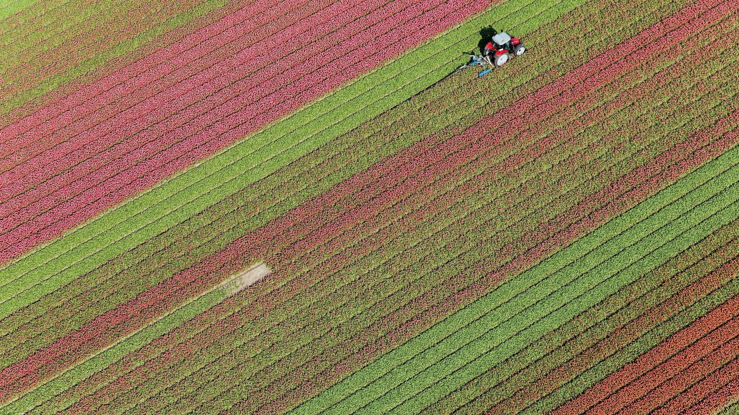
Robustness of

Slide 2
Overview
Evaluates reliability and stability of XAI methods (SHAP, LIME) in ML-based Crop Recommendation Systems.
Focuses on explanation behavior under noise and model uncertainty.
Agriculture data is noisy and uncertain.
XAI explanations are often assumed reliable.
Misleading explanations can cause risky decisions.
Need for stability evaluation in real-world settings.

Slide 3

Related Work and Gaps
SHAP and LIME widely used.
LIME is known to be unstable.
Gaps-
- No confidence-aware analysis.
- No domain-aware noise modeling.
- Limited agricultural multi-class studies.

Slide 4
Key Contributions
Confidence-aware stability analysis (Sure vs Confused cases).
Realistic noise modeling (0%, 2%, 5%).
Validation across Random Forest and & XGBoost.
Correct metric-method alignment.

Slide 5
Experimental Setup
Multi-class Crop Recommendation Systems.
Features: Soil nutrients and climate.
Models: Rando Forest, XGBoost.
Explainable AI: SHAP, LIME.
Perturbations applied and stability measured.

Slide 6

Stability Metrics
SHAP: Spearman Rank Correlation (ranking consistency).
LIME: Jaccard Similarity (top-k feature overlap).
Computed across samples, noise levels, and models.

Slide 7
Main Results (Summary)
SHAP stability ≥ 0.97 across all cases.
LIME degrades with noise and uncertainty.
Confused predictions show lower stability.
Trends consistent across both models.

Slide 8
Key Observations
  SHAP is robust to noise and uncertainty.
  LIME is sensitive, especially in confused cases.
  Explanation reliability depends on model confidence.
  Instability is method-dependent, not model-dependent.

Slide 9

Scientific and Practical Impact
Improves trust in AI-driven agriculture.
Supports risk-aware farming decisions.
Advances research in trustworthy and reliable XAI.

Slide 10
One-Line Summary
A confidence-aware, noise-sensitive, and model-independent evaluation of XAI stability in Crop Recommendation Systems.

